Slide 1
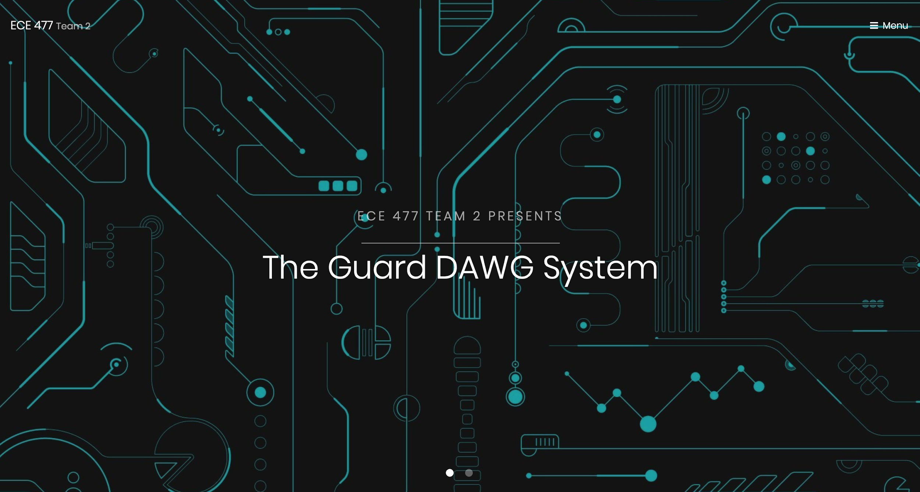

ECE477 MIDTERM DESIGN REVIEW: TEAM 2

Slide 2




Who We Are
Evan Miller
Team Leader
Yash Nain
Hardware Engineer
Ian Sibley
Software Engineer
Viktoryia Zhuleva
Systems Engineer
Notes:
Everybody introduces themselves.

Slide 3
OUTLINE
Project Overview
Block Diagram
Major Components
Packaging Design
Electrical Schematic
PCB Layout
Prototyping Progress
Software Development Status
Project Timeline
Questions
Notes:
Evan

Slide 4
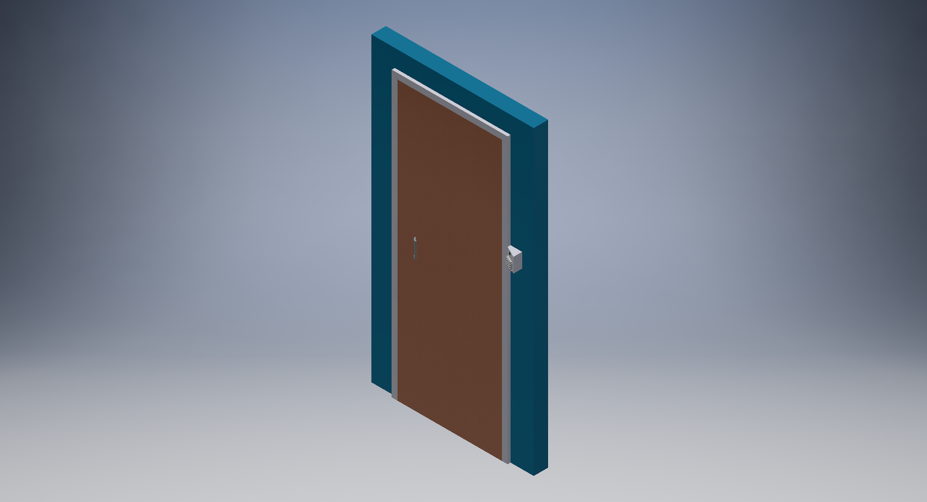
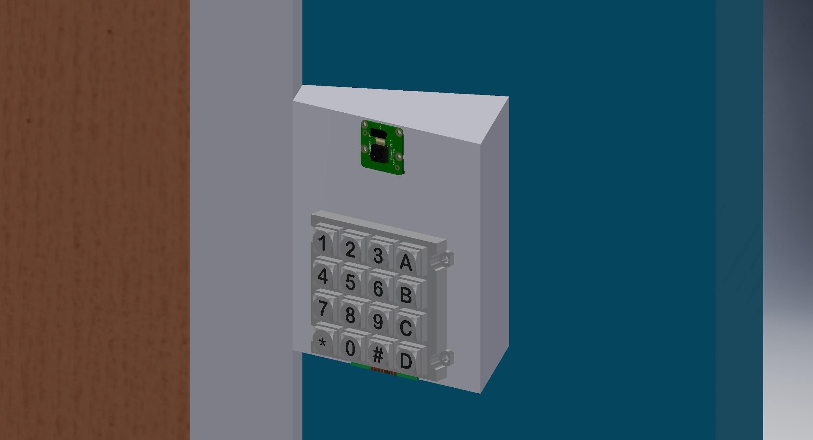
PROJECT OVERVIEW
The Guard DAWG System is a door mounted system using facial recognition to grant access to registered users, with an alternate keypad bypass for convenience, if needed
Notes:
EVAN
In this section provide a concise description of your project. What is it? What will it do? What differentiates it from similar projects and prior art? Include a relevant picture of your project or “artist rendering” of the completed project.

Slide 5
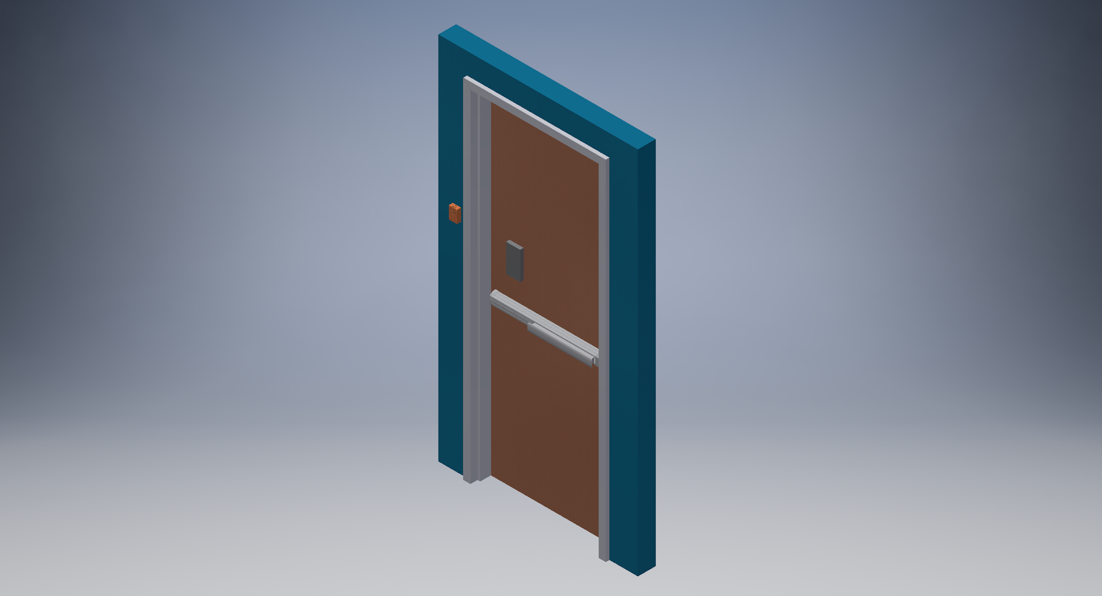
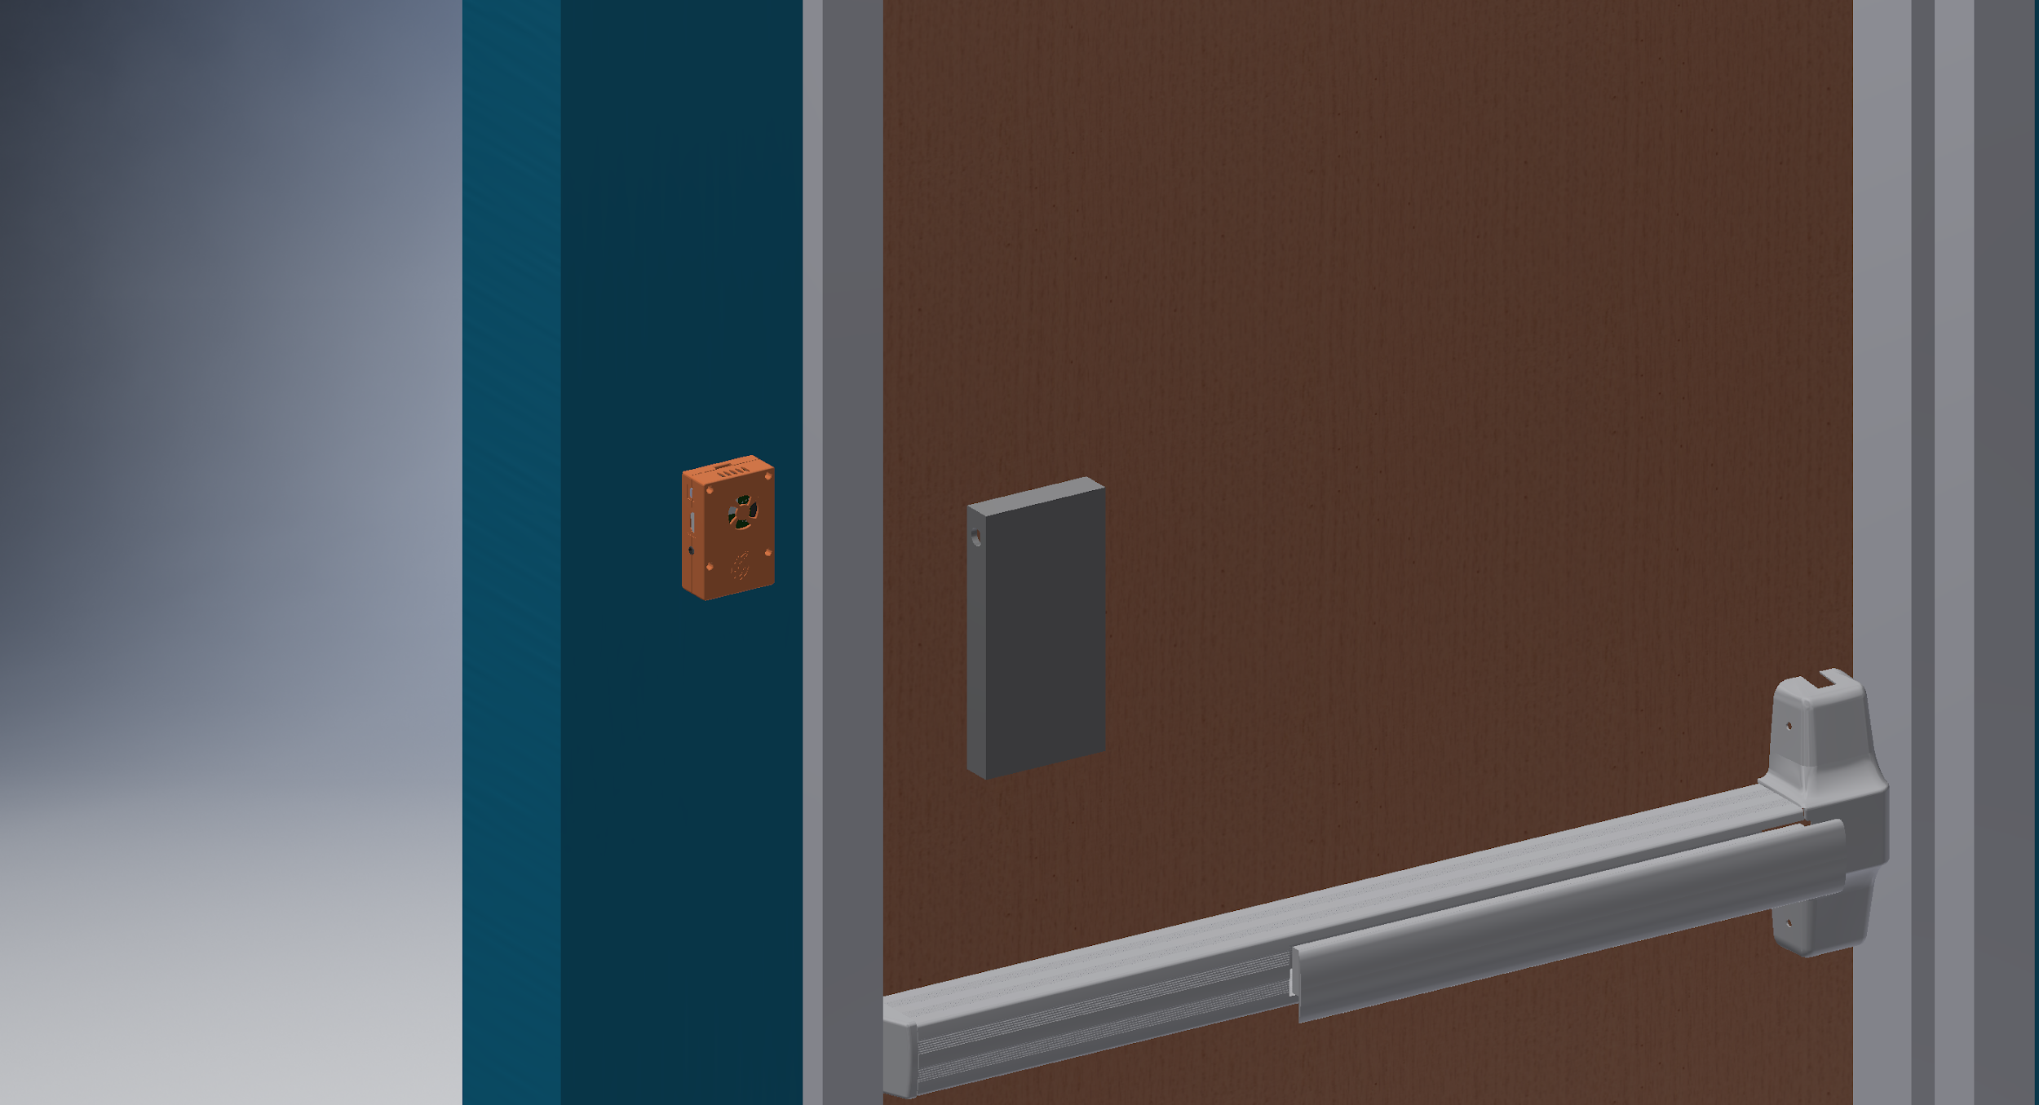
PROJECT OVERVIEW
Similar door mounted systems do not use facial recognition, usually allowing homeowners to see and talk to visitors only
The Guard DAWG system also has the flexibility to be implemented in across commercial and residential properties
Notes:
EVAN
In this section provide a concise description of your project. What is it? What will it do? What differentiates it from similar projects and prior art? Include a relevant picture of your project or “artist rendering” of the completed project.

Slide 6
PSSCS
PSSCs
An ability to read video frames from an embedded camera at 4 frames per second.
An ability to receive a password from a numeric keypad.
An ability to communicate through UART to receive user verification.
An ability to interface with a motor driver IC.
An ability to process image data to recognize a registered face.
Notes:
Evan

Slide 7
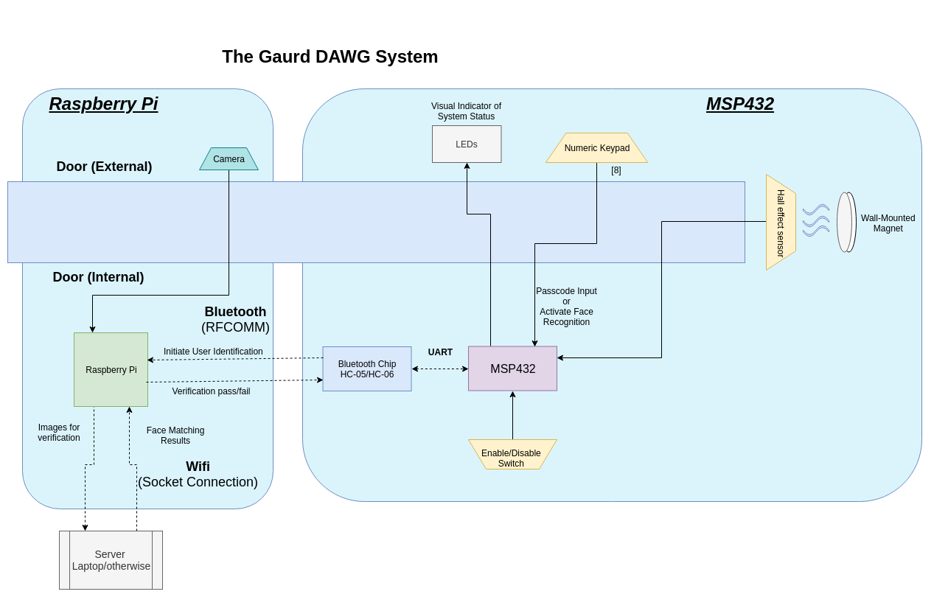
BLOCK DIAGRAM
The Guard DAWG System
Notes:
Viktoryia

Slide 8
MAJOR COMPONENTS
MSP432P401R Microcontroller:
Low power microcontroller with clock speeds up to 48Mhz
Operating voltage between 1.62V to 3.7V
48 GPIO pins and standard bus protocol support for the requirements of the project, namely UART
Raspberry Pi Model 3 B+:
single board computer with a 4 core CPU running up to 1.2GHz
1Gb of Ram, 5.1V @ 2.5A operating voltage
Wifi and bluetooth functionality built-in, large development community online
Used to stream to a remote server and talk over Bluetooth with the MSP432
HC-05 Bluetooth Module:
UART Bluetooth 2.0 module, used in slave mode
Von Duprin 98/99 push bar, model QEL:
Provides a simple electrical interface
showcases how the system on a common locking mechanism
Notes:
Ian
NO MSP430

Slide 9
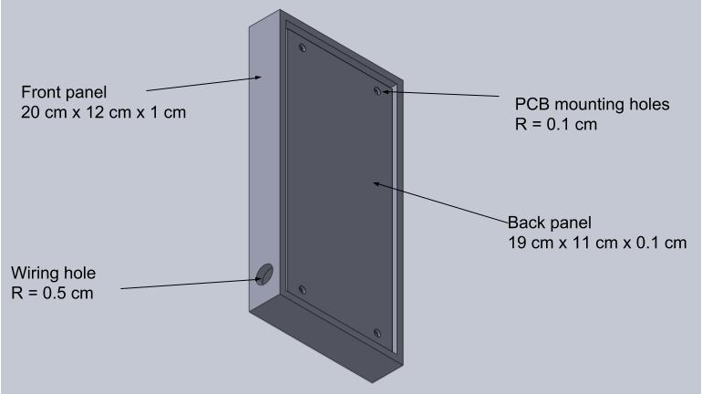
PACKAGING DESIGN - I
Notes:
Yash

Slide 10
PACKAGING DESIGN - II
Manufacturing Plan
Material: ABS (version 1)
3D Printed Housing for Raspberry Pi, through-holes for adding metal mounting points with screw/nut
Do not want to thread 3D printed material for stability
PCB has M4 mounting holes, male-to-female slots for keypad, rubber seal for waterproofing
Notes:
Yash
Include one or more images of your packaging design here. Include relevant dimensions and how you are planning to manufacture your product packaging.

Slide 11
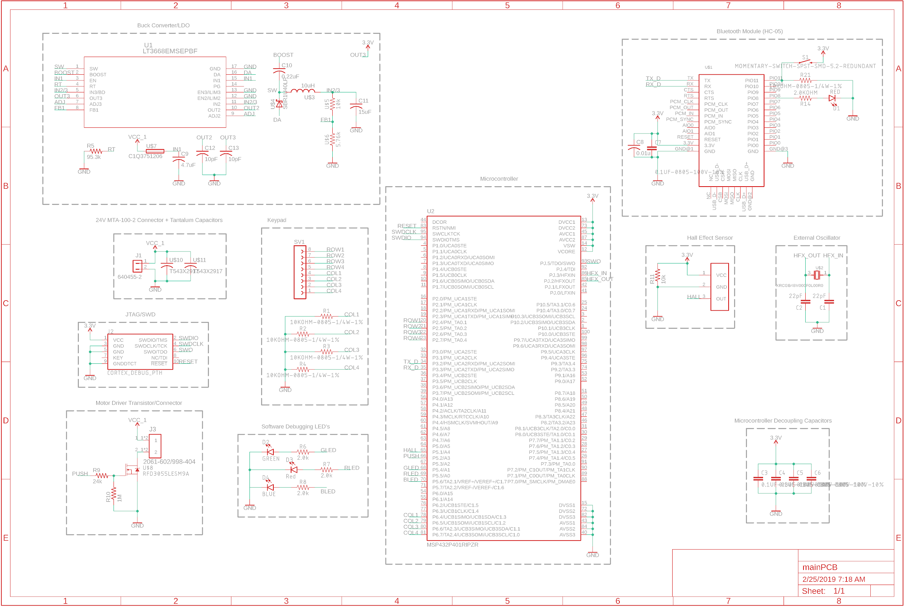
ELECTRICAL SCHEMATIC
Figure 1: Full View
Notes:
Yash

Slide 12
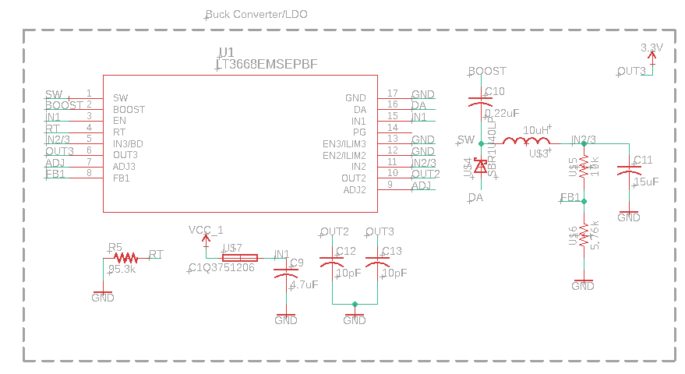
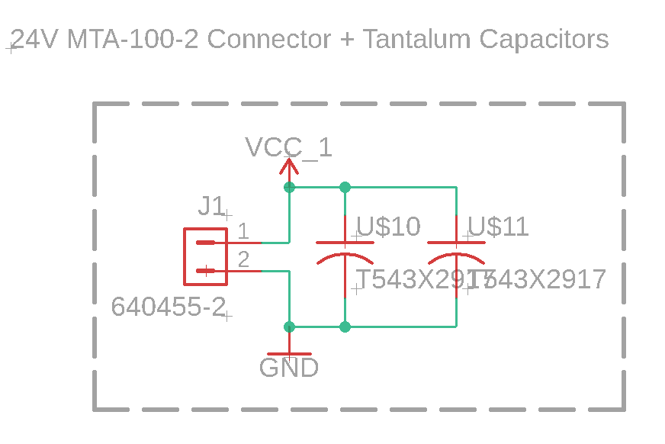
Electrical Schematic
Power Board
Uses all-in-one Buck Converter/LDO, along with fuse to convert 24V/1A to 3.3V/150mA
High-performance tantalum capacitors to ensure board remains powered under load from motor

Slide 13
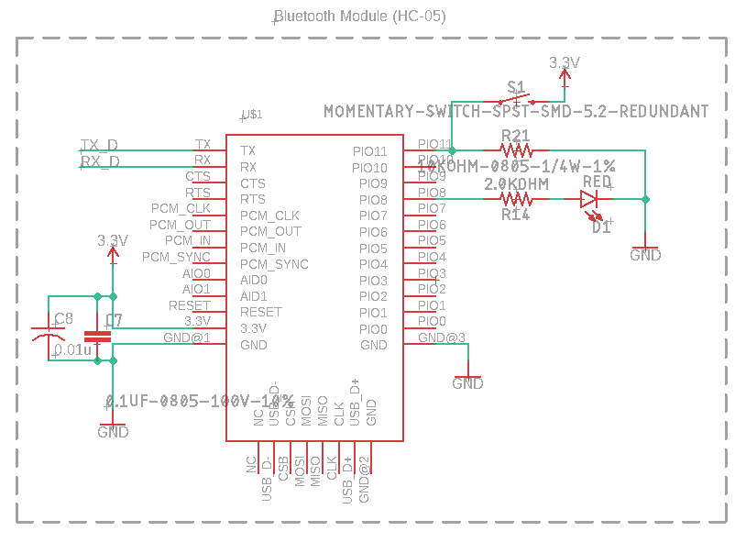
Electrical Schematic
Bluetooth Module
HC-05 Module
Interface with uC through UART
Decoupling Capacitors
Reset switch, debugging LED

Slide 14
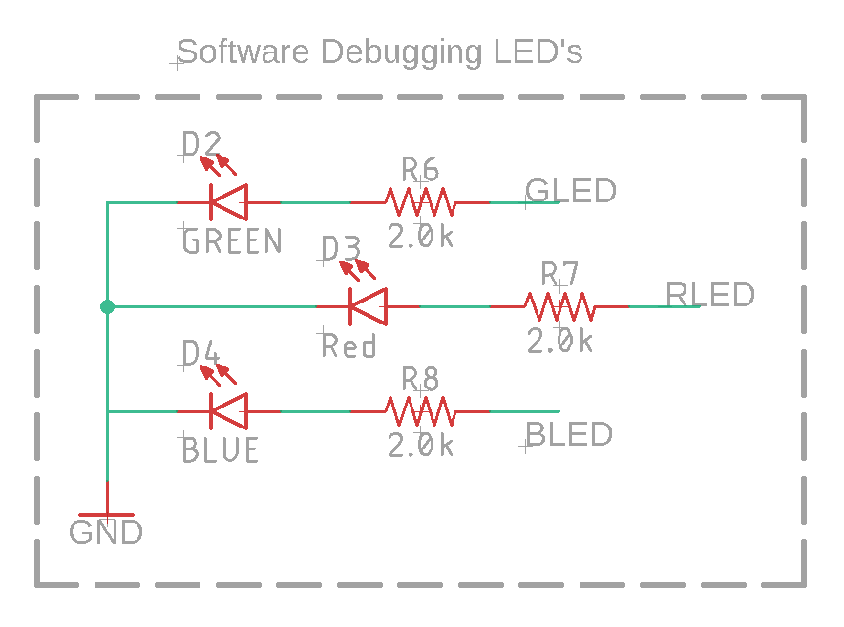
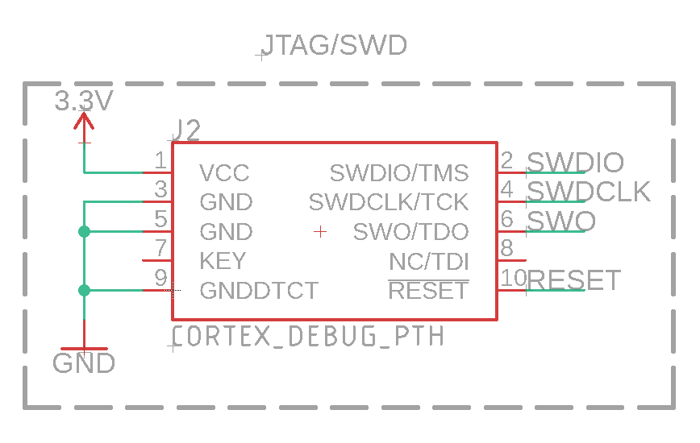
Electrical Schematic
Programming + Debugging
10-Pin JTAG/SWD Cortex connector for programming/debugging uC
Red - Blue - Green LED’s that can be activated by software to check state for debugging purposes

Slide 15
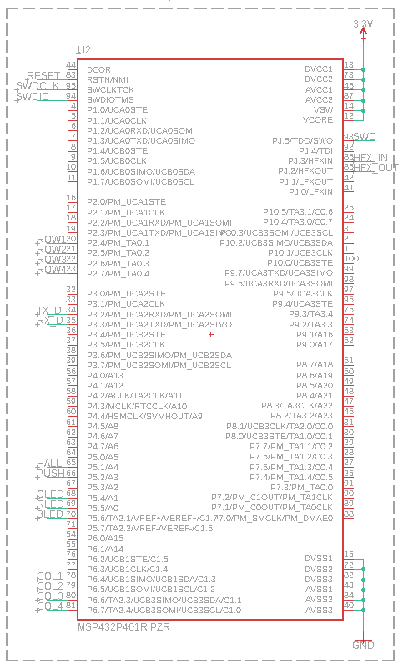
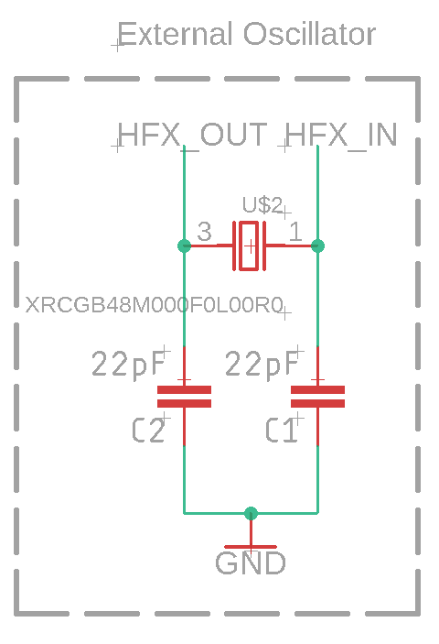
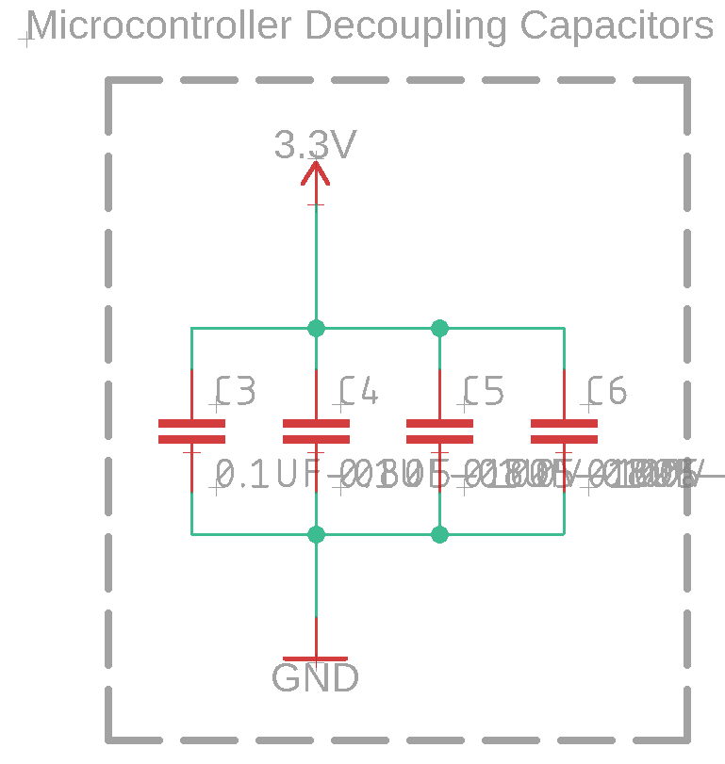
Electrical Schematic
uC, External Oscillator, and Decoupling Capacitors
MSP432P401R Microcontroller, with 0.1uF decoupling capacitors
One for every power-ground connection, and another for good measure
Murata 48 MHz crystal oscillator, to act as high-speed precision clock source

Slide 16
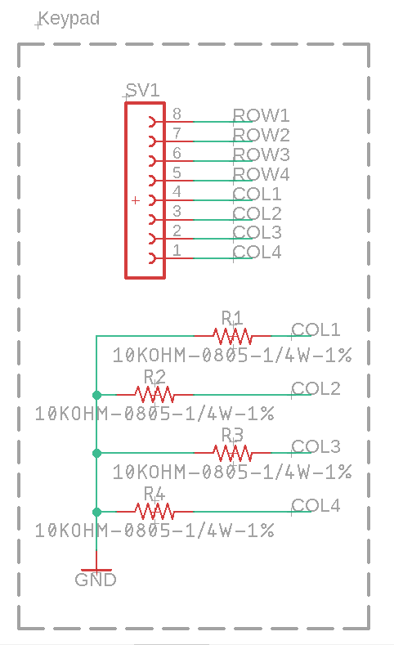
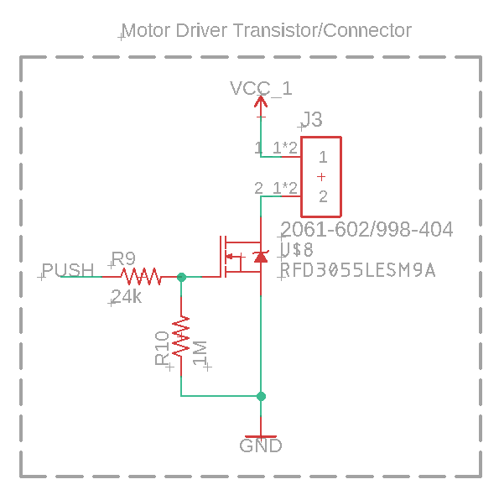
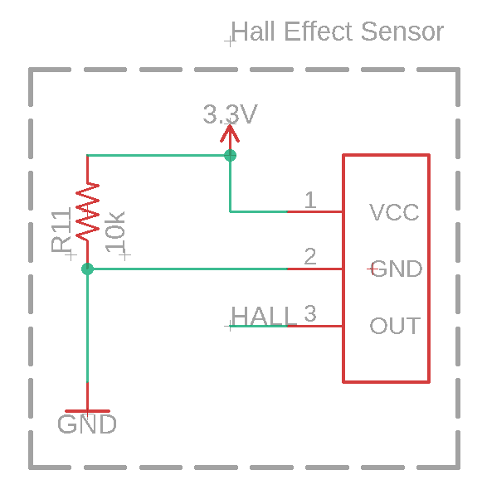
Electrical Schematic
External Interfacing
Numeric Keypad
Motor Driver FET
Hall Effect Sensor

Slide 17
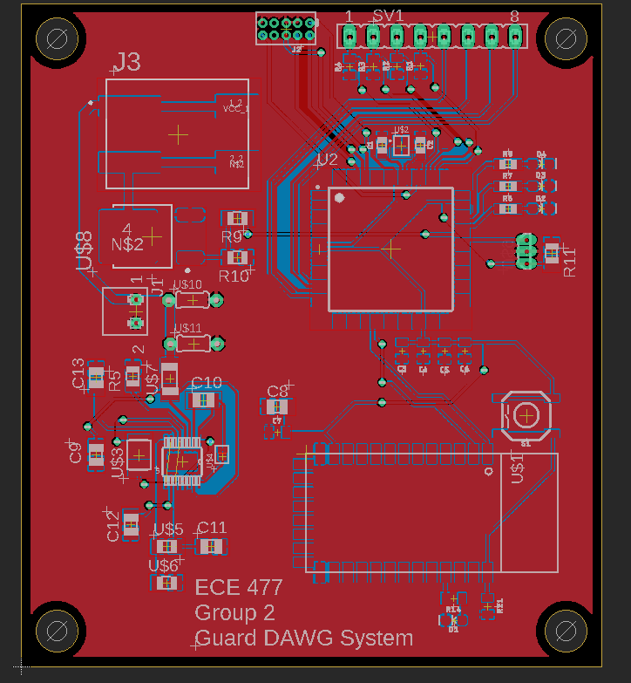
PCB LAYOUT
Full Layout
2.5” x 2.8”
Ground Plane
Notes:
Yash

Slide 18
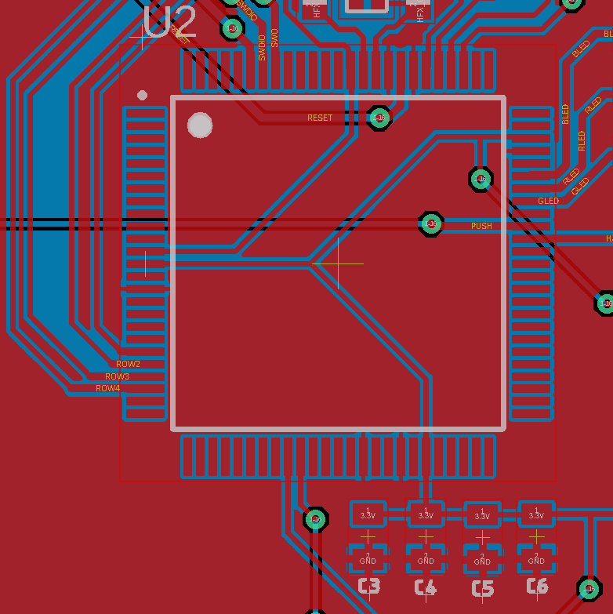
PCB LAYOUT
Microcontroller View
Decoupling Capacitors underneath

Slide 19
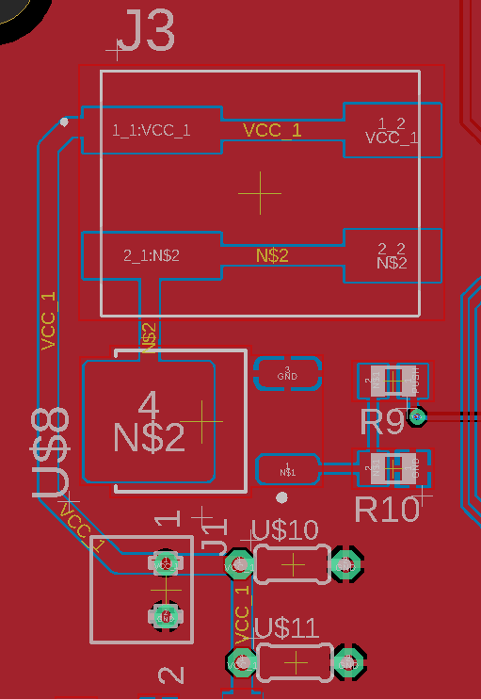
PCB LAYOUT
Power Connectors
Terminal Block for Von Duprin Motor cable
Motor Driver FET beneath that, along with 24V source and Tantalum

Slide 20
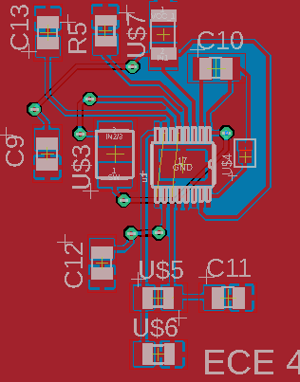
PCB LAYOUT
Buck Converter + LDO
Use LT3668 Chip as Buck converter, LDO
High-precision resistors, Fuse to limit current draw

Slide 21
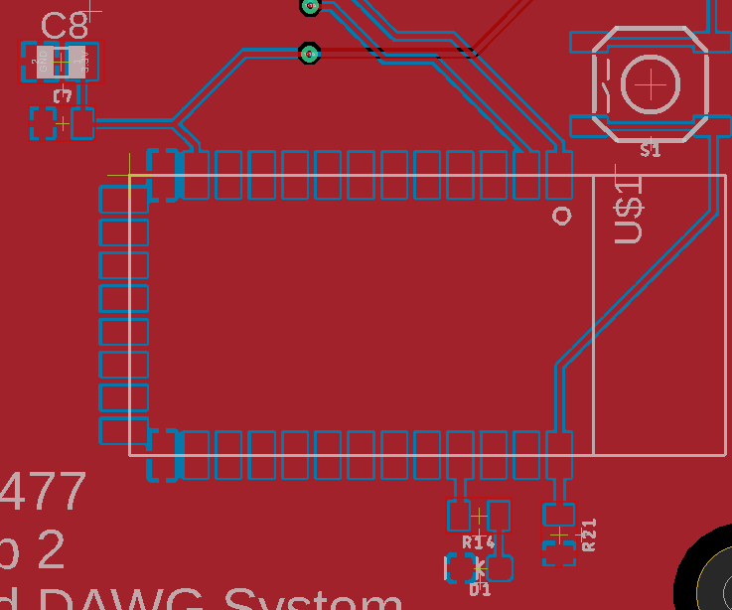
PCB LAYOUT
Bluetooth, Button, and Capacitors
Bluetooth module comes with button for reset, state LED
Decoupling capacitors

Slide 22
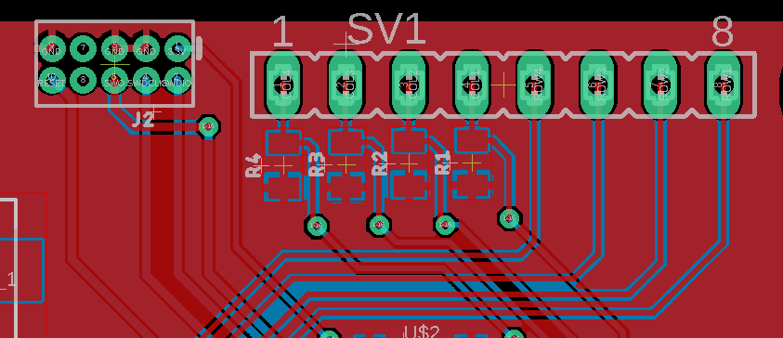
PCB LAYOUT
JTAG/SWD Connector + Keypad Connector
Pull-down resistors for Keypad

Slide 23
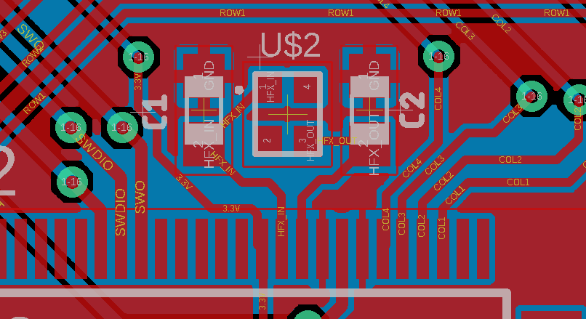
PCB LAYOUT
48 MHz Crystal Oscillator
22pF capacitors for C_load
Traces as equal length as possible after capacitors

Slide 24

PCB LAYOUT
Mounting Holes
Yes, we have them
M4 hole size

Slide 25
PROTOTYPING PROGRESS
Software
Embedded
HC-05 Bluetooth working, acting as a slave device
Keypad working in a row-column decoding layout
recent rerouting of the pins to consolidate involved interrupts
Raspberry Pi/Server
All basic functionalities currently functioning
remaining steps involve pulling pieces together into the application code
Hardware
Door Motor
Able to lock and unlock the door
Notes:
Viktoryia
Describe your team’s prototyping progress here. For each of your project’s major components, what has been tested? What is known to work? What still needs to be tested, and what still needs to be proven to work?

Slide 26
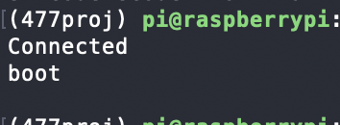
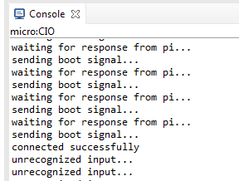
SOFTWARE DEVELOPMENT STATUS - I
Bluetooth Communication
Established a successful connection between the micro, bluetooth module, and Raspberry Pi (Complete)
Determining packet sizes and relevant information to send
between the MSP432 and Raspberry Pi (In testing)
Currently stable at 1-2 characters
Enough for application testing to progress, but a fix is desirable
Integrating UART receiving interrupt into the MSP432 overall software design (In development)
Keypad Events
Used polling to effectively decode which button was pressed (Complete)
Making key presses use interrupts and dealing with debouncing concerns (In development)
Notes:
Viktoryia
In this section, detail team progress with software development. List out the major modules for your team’s software. For each module, detail its status (Not yet started / In development / In testing / Completed)

Slide 27
SOFTWARE DEVELOPMENT STATUS - II
Miscellaneous
Hall effect sensor producing correct digital output in the presence of a magnet (Complete)
Timer module configuration to deal with timeout events (In development)
Interfacing with the push bar to drive locking and unlocking (In development)
System Integration
State diagram detailing planned component integration (Complete)
Focusing on main unlocking methods using the keypad and Raspberry Pi (In development)
Bluetooth transmission required, start recognition and pass/fail response
Notes:
Evan
In this section, detail team progress with software development. List out the major modules for your team’s software. For each module, detail its status (Not yet started / In development / In testing / Completed)

Slide 28
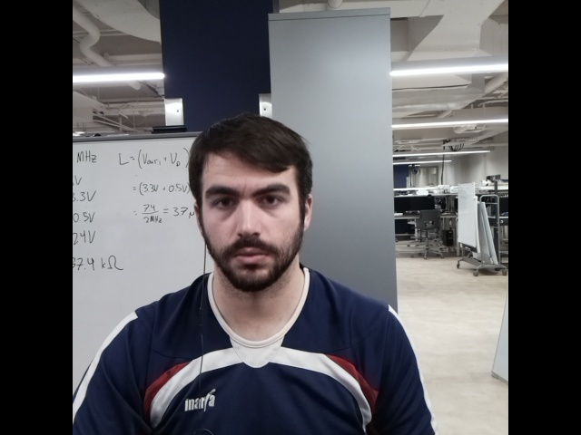
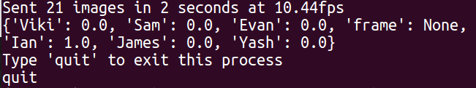
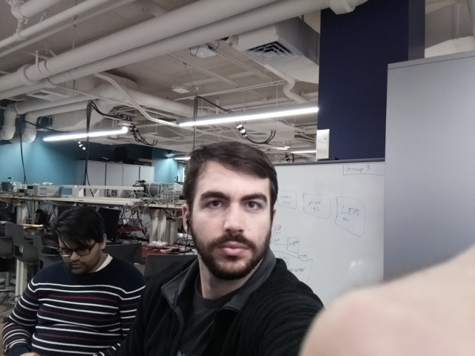
SOFTWARE DEVELOPMENT STATUS - III
Facial Recognition System (Raspberry Pi)
Establish socket connection with "server"/laptop (Complete)
Requires knowing the IP address of the machine desired
Currently recovering connection if dropped
Capture & stream images from the camera (Complete)
Receive results of facial recognition through socket (Complete)
Gain Bluetooth connection with HC-05 (Complete)
Receive varying length messages (Complete)
Testing recovering lost connection (In Progress)
Return Pass/Fail signal via Bluetooth (In Progress)
Notes:
Ian
In this section, detail team progress with software development. List out the major modules for your team’s software. For each module, detail its status (Not yet started / In development / In testing / Completed)

Slide 29
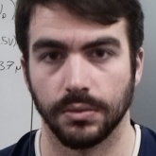
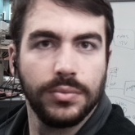


SOFTWARE DEVELOPMENT STATUS - IV
Facial Recognition System ("Server"/Laptop)
Establish connection with Raspberry Pi (Complete)
Accept streamed images and find feature vectors (Complete)
Includes testing both FaceNet and a DLIB based Python library, face_recognition
face_recognition was more application-friendly, and much faster
Evaluate against known users' features (Complete)
Only consider largest face in image (Complete)
Return JSON of percent registered user matches (Complete)
Normalized per person
Allow for new user registration (In Progress)
Currently separate python script
Notes:
Ian
In this section, detail team progress with software development. List out the major modules for your team’s software. For each module, detail its status (Not yet started / In development / In testing / Completed)

Slide 30
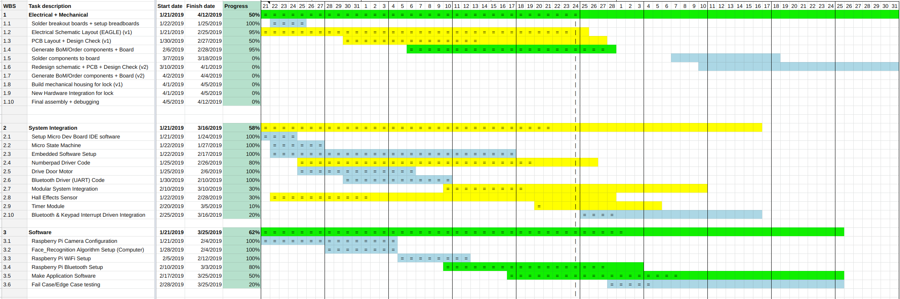
PROJECT TIMELINE
Gantt Chart
Notes:
Viktoryia

Slide 31
3D PRINTING
Questions?
Notes:
Viktoryia

